Slide 1

Dr. D. Y. Patil Institute of Technology, Pimpri
Department of Electronics & Telecommunication Engineering
Project Stage-I Presentation on
“Advanced Communication System for Blind and Deaf People ”
Group Members:
Shubhada Govind Dandawate
Ankush Tukaram Darade
Hetal Bhushan Kini
Under the Guidance of: Dr. P. H. Kulkarni

Slide 2
Advanced Communication System for Blind and Deaf People

Slide 3
Introduction
There’s a problem of communication between blind and deaf . So there’s a need of a system which will help them to communicate with each other.
We are concern to have a system which will provide a language support for ease of understanding while communicating.
As we are in the age of technology enhancement is reaching at personalize electronic assistance but we feel that there is a requirement for an electronic translator for physically challenged people. We’ll be focusing on blind as well as deaf people.
The deaf persons uses different gestures during communication for example hand movement, typing, etc. while blind persons opt for Braille Lipi.
Using this as a way of communication for reading the blind people depend on this method by keeping hand on letter structure and the deaf persons can read the data.

Slide 4
Objective :
To make electronic-interface between blind and deaf peoples.
To make system more stable
To make a Portable system
To make User Friendly device
To make a Cost Effective product

Slide 5

Literature Review :
Sr. no. | Paper Title | Author names | Journal details (IEEE format) | Cons of Paper
1. | Braille Band: Blind haptic wearable band for communication using braille language. | Savindu H.P.,Iroshan K.A.,Panangala C.D., Perera W.L.D.W.P., De Silva A.C. (MIEEE) | Connectivity between the Braille Band and the phone is established using Bluetooth. It consists of six nodes in three bands worn on the arm to map the braille alphabet, which are actuated to give the sense of touch corresponding to the characters. It consists of a microcontroller, a Bluetooth module and six haptic motors | Lack of voice facility. There’s a delay while sensing vibrations.
2. | A Low-Cost Wireless Braille System Hand Glove for Real Time Communication | Hasan U. Zaman, Khalida Sultana Shuravi, Muntasir Kabir Sakib, Mohammad Wasee Sarwar, Department of Electrical and Computer Engineering North South University Dhaka, Bangladesh. | This glove allows the person to type characters based on different braille combination using six slot sensors. The vibration in six different positions of the glove which matches to the braille code allows them to read characters. It consists of slot sensors, vibration motors, Motor Driver IC, Comparator IC Circuit, AVR Microcontroller Development Board. | It requires voice facility because it is heavy due to addition of circuit on glove.

Slide 6

3. | Computerised Deaf, Dumb and Blind. | Ms. Rashmi R Gundams, Sonail S Handigundms, Sudharani S Biradar, Department Of Electronics & Communication Engineering, S D M College Of Engineering and Technology, Dharwad. | In this project image processing is used to recognize gesture, comparing that with stored database, recognizing correct expression using MATLAB and displaying output in the form of voice through voice processor. On other side speech of blind person is transmitted to pc through mike. Speech signal is processed through MATLAB present in the pc and displaying as text through LCD by interfacing with micro controller. | Not portable. It needs software.
4. | Smart Glove for Blind and Deaf Blind People. | Riham AL Nazer , Nadeen Shaheen, Palestine Polytechnic University College of Information Technology and Computer Engineering. | The Smart-Glove has a set of pushbutton switches. Blind user can write messages through pressing pushbuttons located on the Smart-Glove. Hence different Pushbutton patterns correspond to different braille codes. These braille codes are sent by Bluetooth to the mobile, where they are converted to display the corresponding alphabets, words and sentences. | Sometimes it becomes difficult to sense vibrations.

Slide 7
Problem Statements
Difficulty in communication. Can't communicate through call or text. Language Barrier.
Price of a braille display is high.
Traditional braille system blind people required pad, stylus & scale.
Solenoids are used, which are costly.
There’s a need of communication between them.
Requirement of an electronic translator.

Slide 8
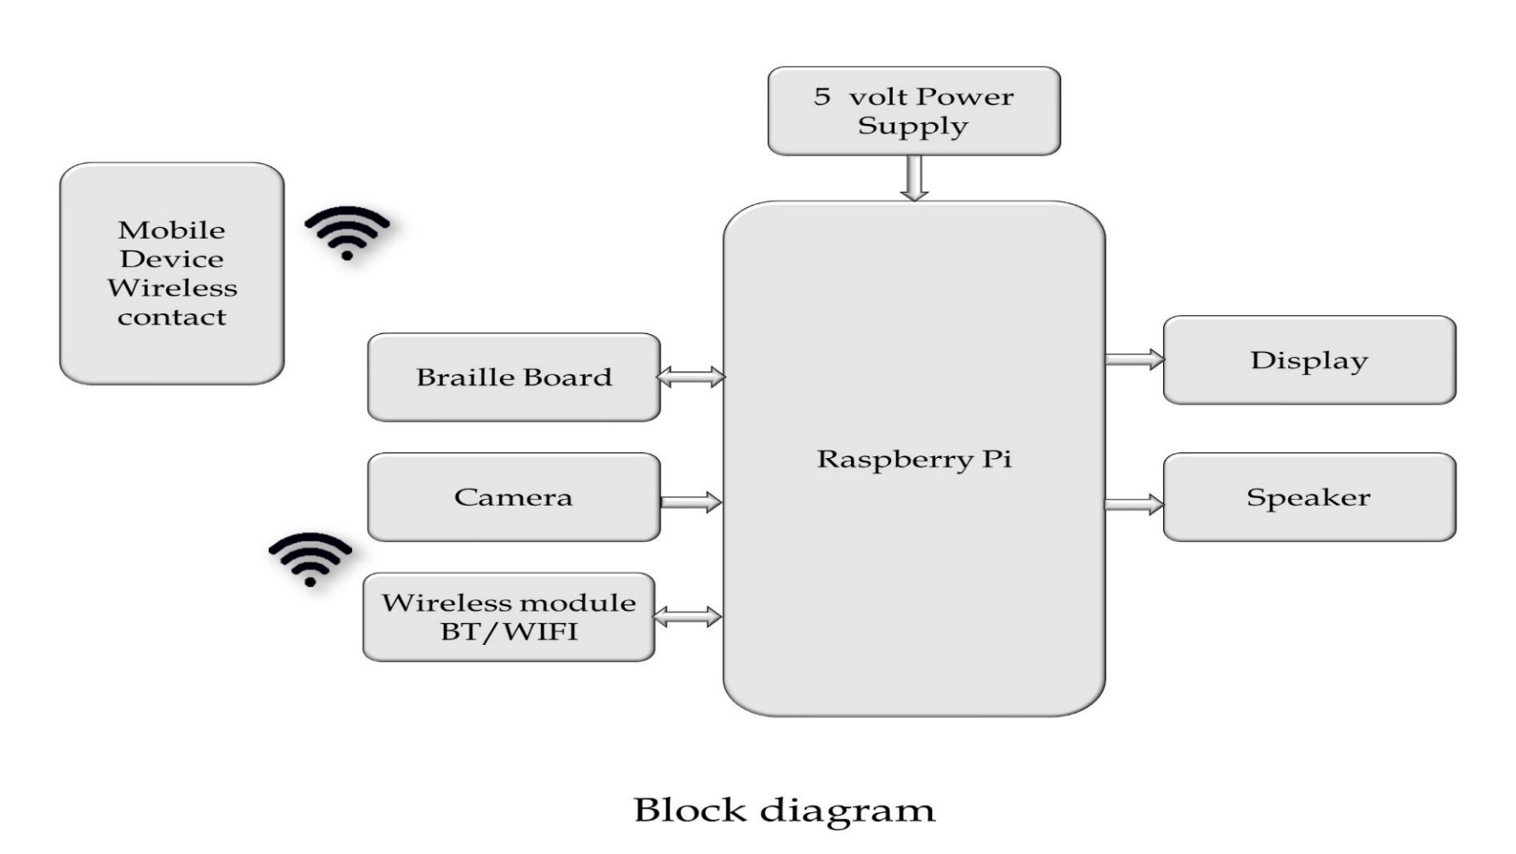
Block Diagram

Slide 9


Short Working (Blind and Deaf)
Receive the message
A
Receive the input from Brille board and after controlling send to Mobile and Speaker

Slide 10
Short Working (Deaf to Blind)
Send the message
controller
A
Receive the input from Mobile and after controlling send to Braille Board
and Speaker

Slide 11
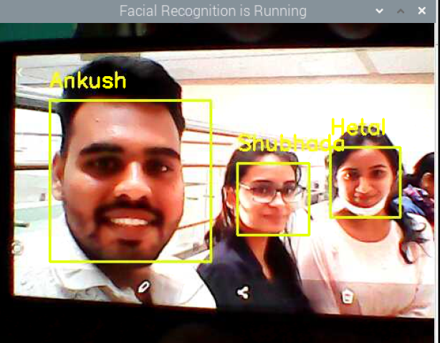
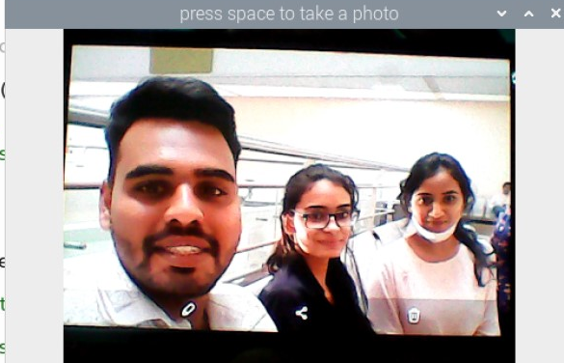
Short Working (Face Detection)
Receive the input from Mobile and after controlling send to Braille Board
and Speaker

Slide 12
Working Description
Blind to Deaf.
Blinds type using braille keyboard.
Text will be given to the controller.
It will be displayed on Mobile Phone.
It will be sent using wireless device.
Deaf to Blind
Deaf people will type the text.
Text will be given to the controller.
Text message will be converted into voice message.
Simultaneously vibrator on the braille Keyboard will vibrate & even through vibrati on the blind people can sense the texts.
Face Recognition
Camera capture image
Check with database
If Match found Speaker Spoken Out Name

Slide 13
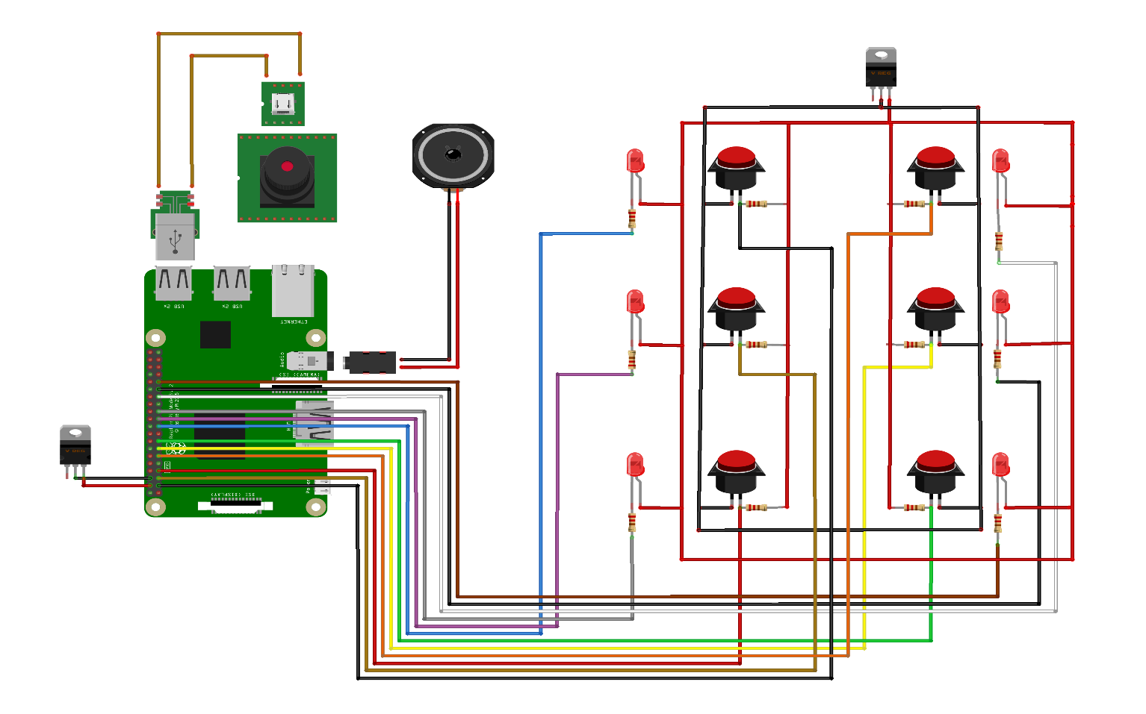
Circuit Diagram

Slide 14
Circuit Diagram Description
Raspberry pi 3B+ Used the GPIO Pins of raspberry pi as (3, 5, 7, 11, 13, 15) these pins are used for push switch. (19, 21, 23, 29, 31, 33) these pins are used for Vibro motor.
Speaker : It is connected to the 3.5mm audio jack.
Camera : The usb camera connect to USB port.
5 volt Power supply : Connect to 5-volt supply to controller.

Slide 15
Specifications
Operating Voltage: -5V
Sensitivity :- 95 % ± 5%
Character gap :-400 - 2000ms
Accuracy:- 90% ±5%
Speed :- 4-6 words/minute.
Mobile android version:- 8+ android version
Connectivity range: -10 m
Operating Frequency:- 2.45GHz.
Transmission rate:- 6 words/minute
Speaker Output power :-65dB -100dB

Slide 16

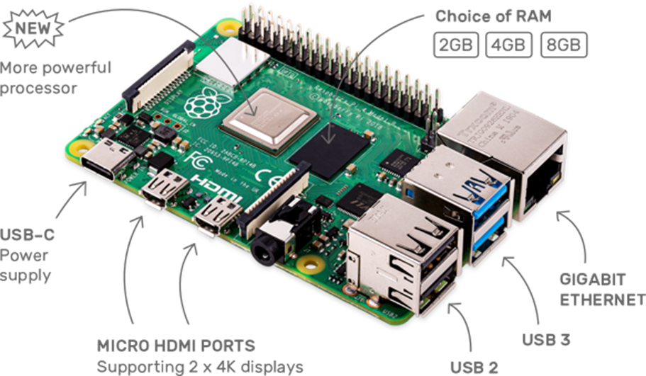
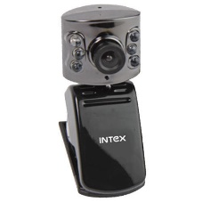
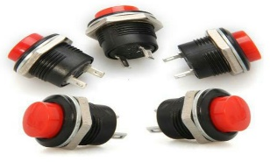
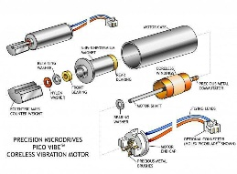
Component List
Sr. no. | Name of Component | Reference from circuit diagram | Specification | Quantity | Price
1. | Raspberry Pie 3b+ |  | Quad core Cortex-A72 (64-bit) @ 1.5GHz64-bit SoC @ 2.4GHz RAM :- 2GB, 2 HDMI (micro), 4 × USB 2x 2.0,2x3.0, 5V/3A DC via type C , MIPI CSI camera port LAN, Bluetooth, Display Port | 1 | 4899
2. | USB Camera |  | Image Sensor - 1/7” CMOS Sensor. Image resolution- 16.0 Mega pixel. Frame rate- 30fps. | 1 | 2000
3. | Push Switch |  | 3A 125VAC; 1.5A 250VAC Temperature Rating: −13 to +185 F (−25 to +85 C) | 6 | 115
4. | Vibratory motor |  | Body Diameter: 6 mm Rated Speed: 11,500 rpm Rated Voltage: 3 V Operating Current: 140 mA | 6 | 800

Slide 17
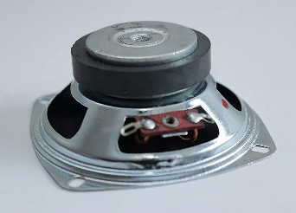
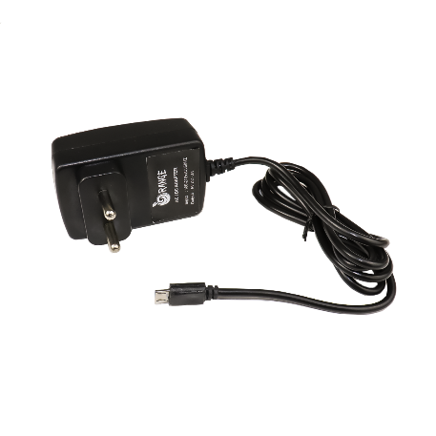
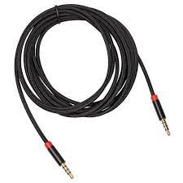
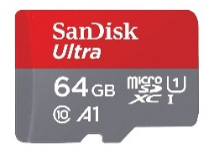
Sr. no. | Name of Component | Reference from circuit diagram | Specification | Quantity | Price
5. | 8ohm Speaker |  | Impedance: 8 Ohm ± 15% at 1 KHz 1V Sound pressure level: 86 dB/w ± 3 dB Resonant frequency: 750 Hz± 150 Hz at 1V | 1 | 450
6. | 5volt Adapter |  | Input Voltage (V): 100 ~ 280 VAC @50 ~ 60Hz Output Power: 5V 3A. | 1 | 550
7. | 3.5mm Audio wire |  | Connect mini-stereo audio equipment up to 1.5m. Molded cables with built-in strain relief 3.5mm Male to Male connectors | 1 | 120
8. | Micro SD card |  | Memory Storage Capacity 64GB Read Speed 120 Megabytes Per Second | 1 | 1000

Slide 18
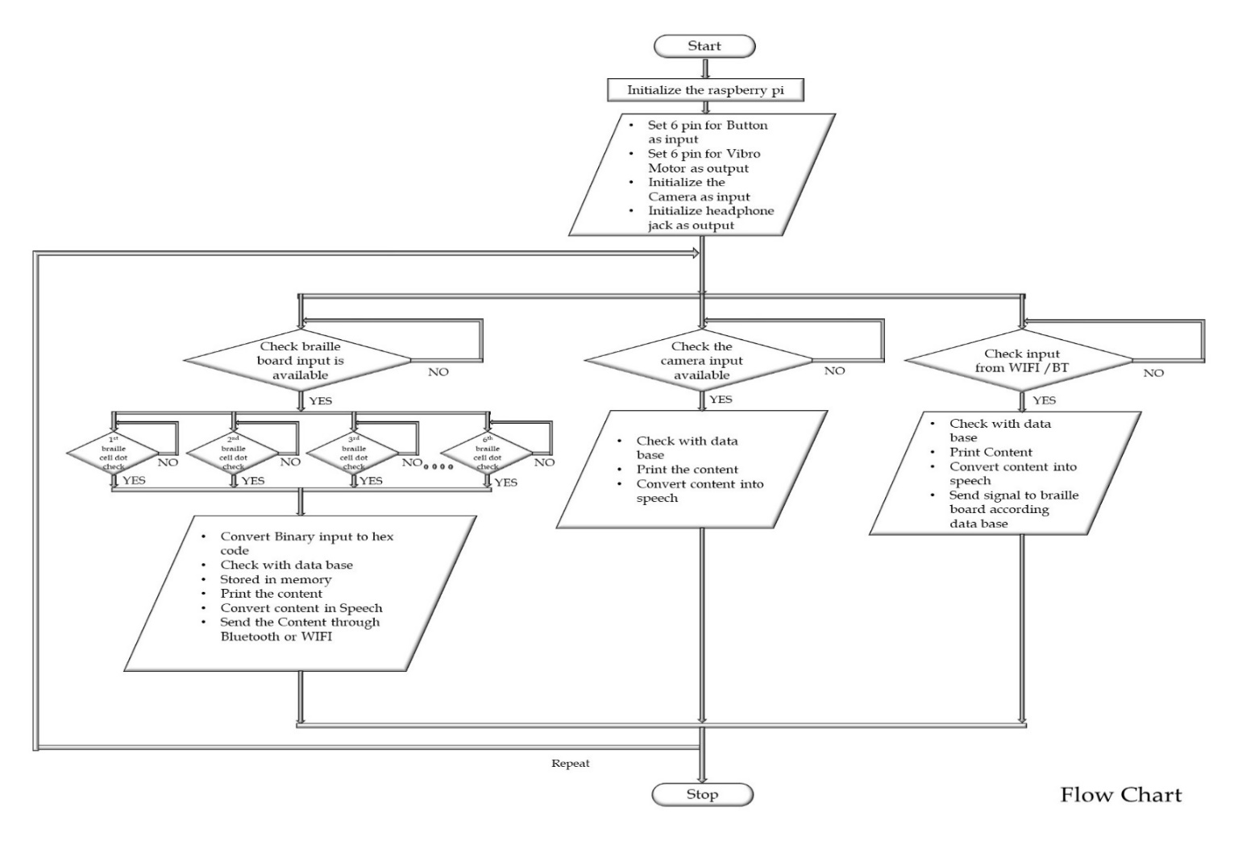
Flowchart/Algorithm

Slide 19
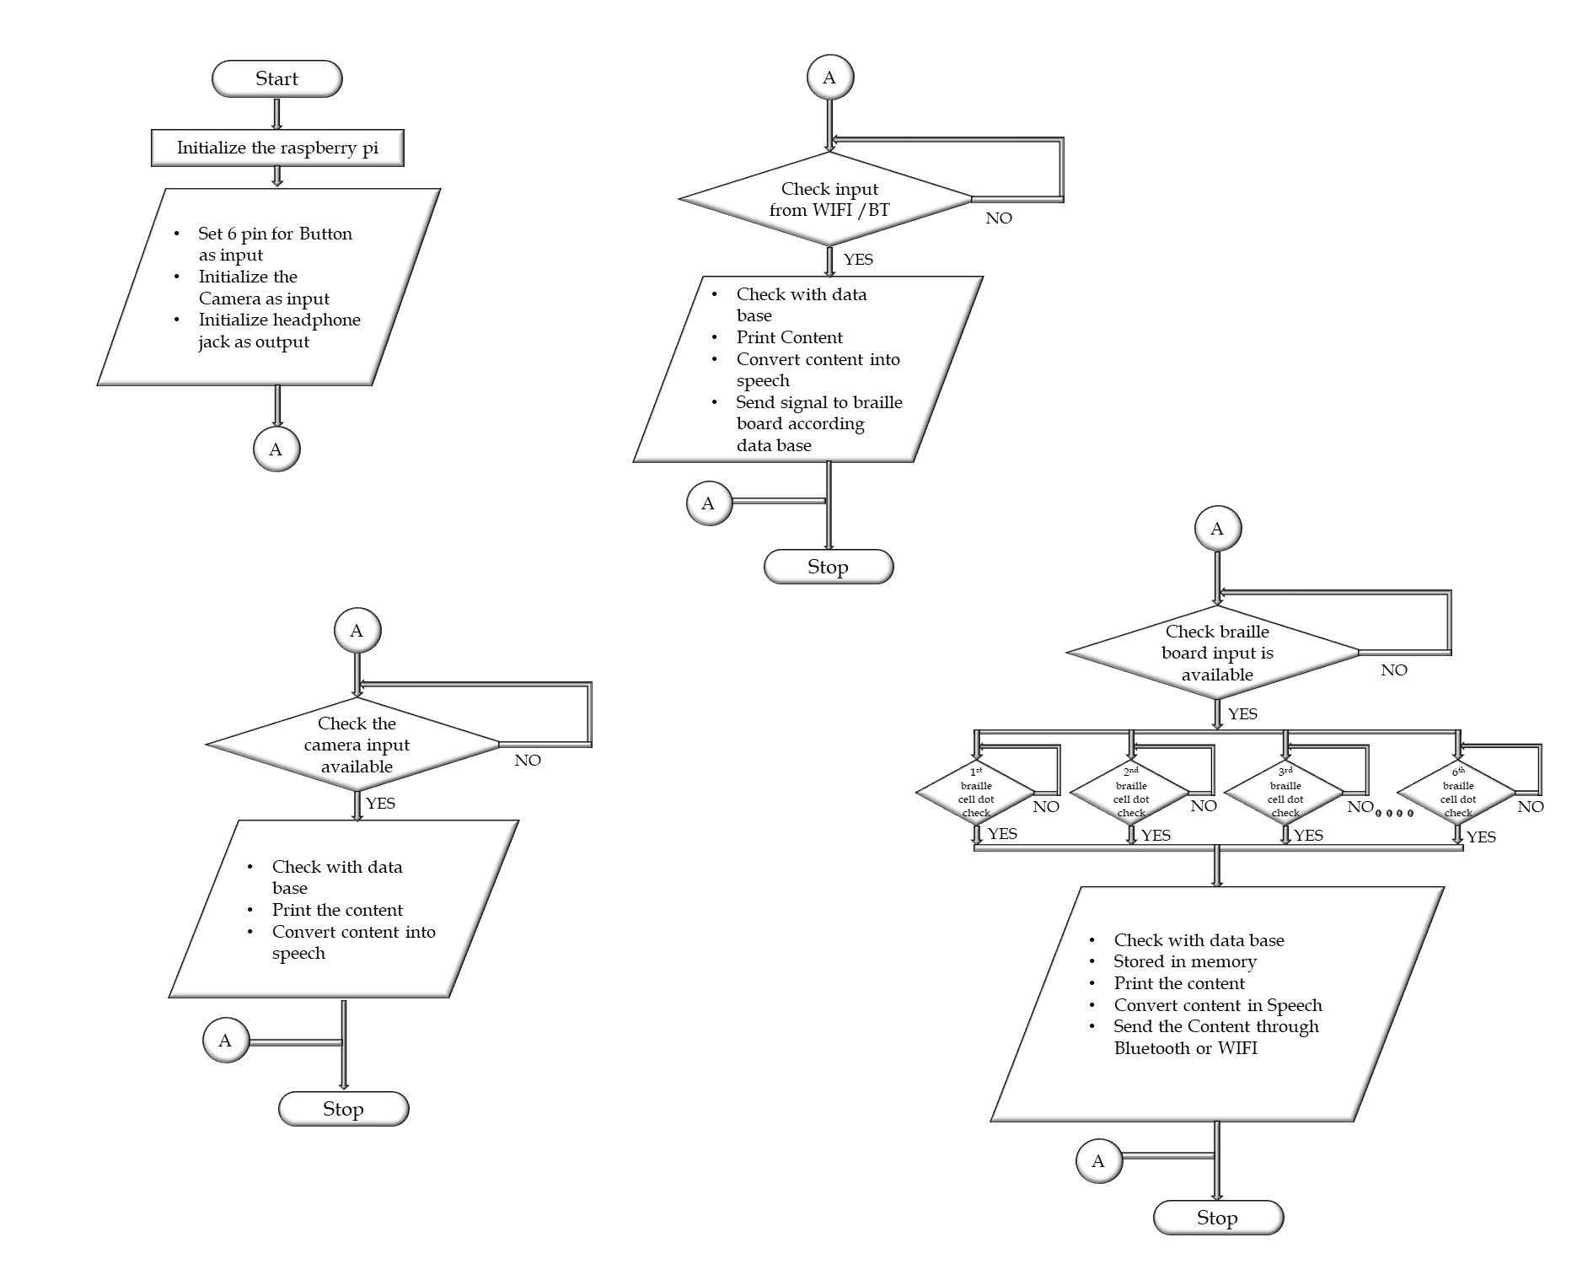


Flowchart/Algorithm

Slide 20
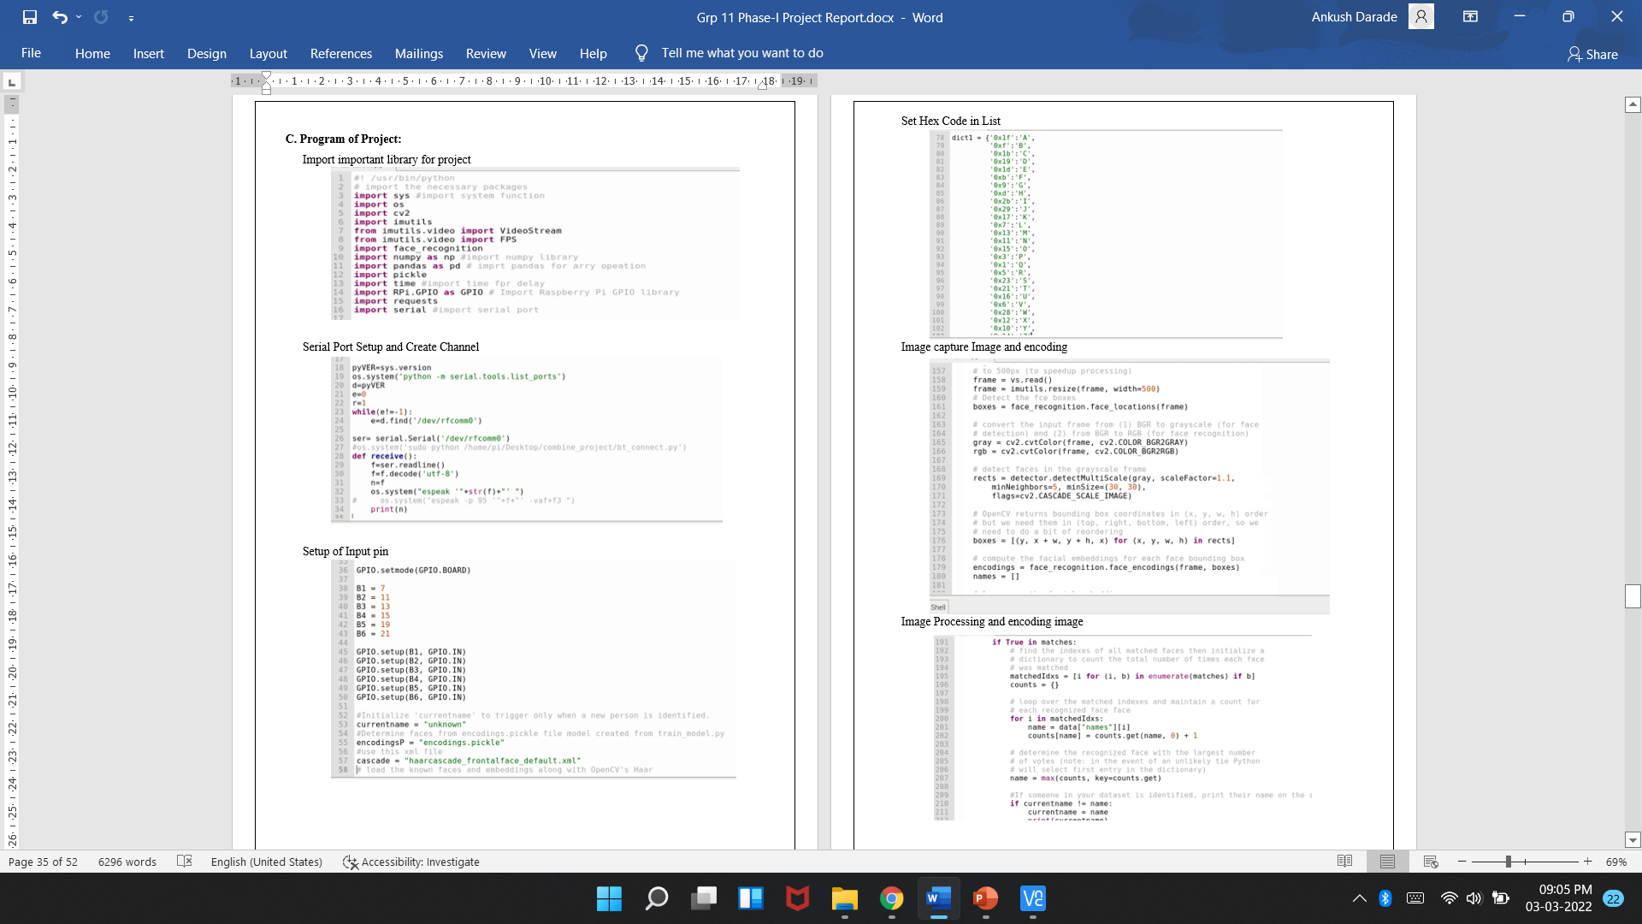
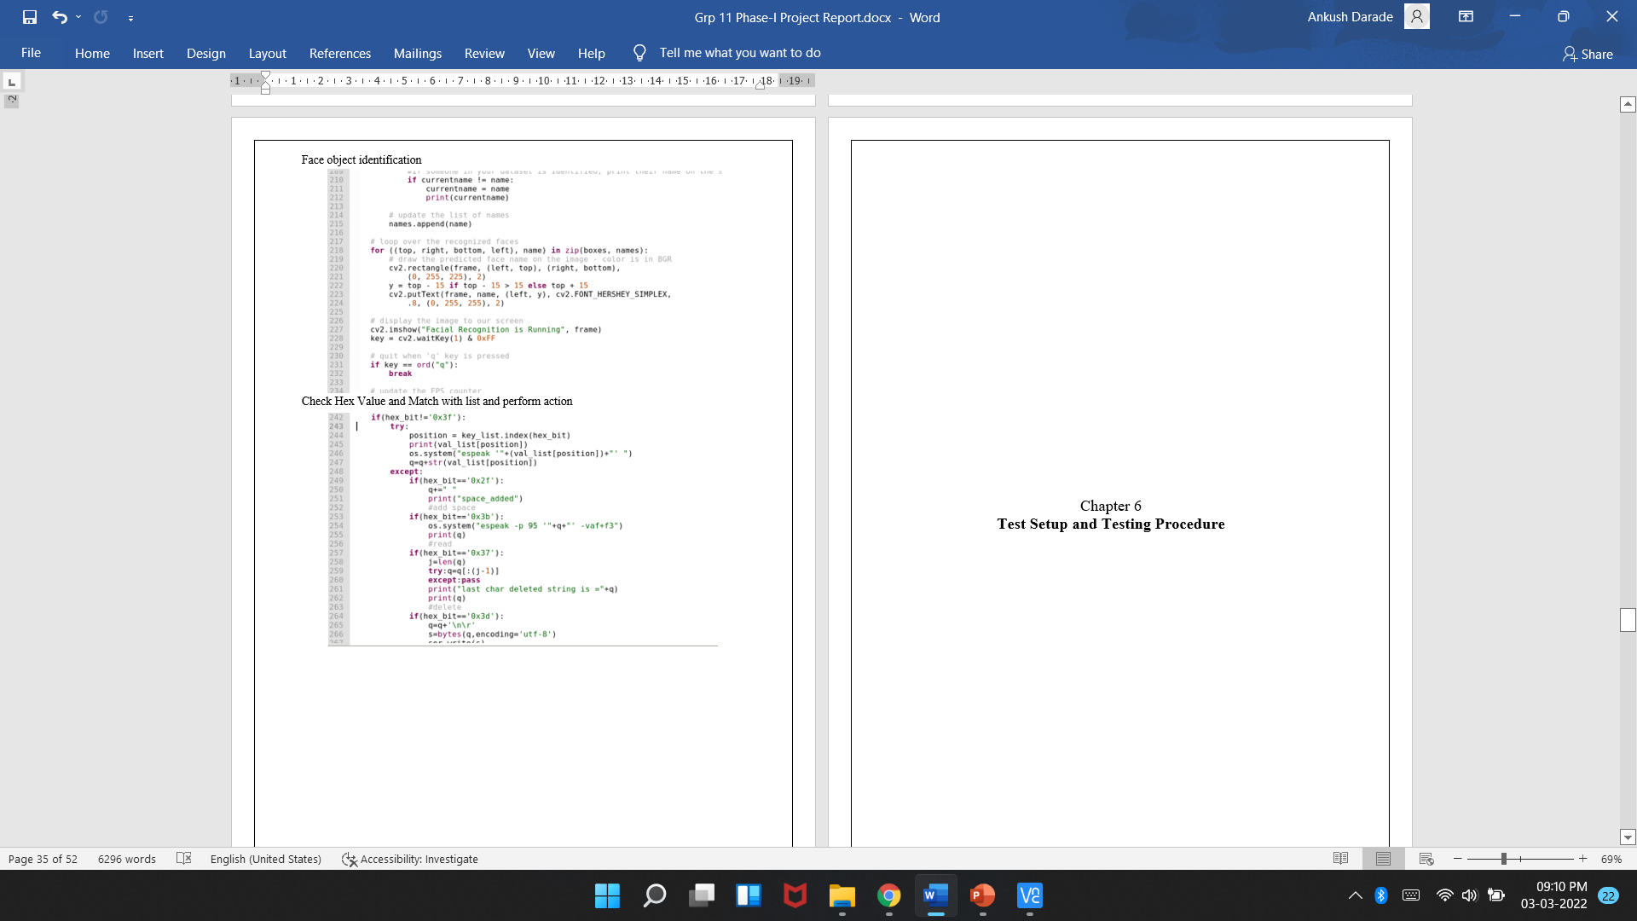
Program of Project

Slide 22
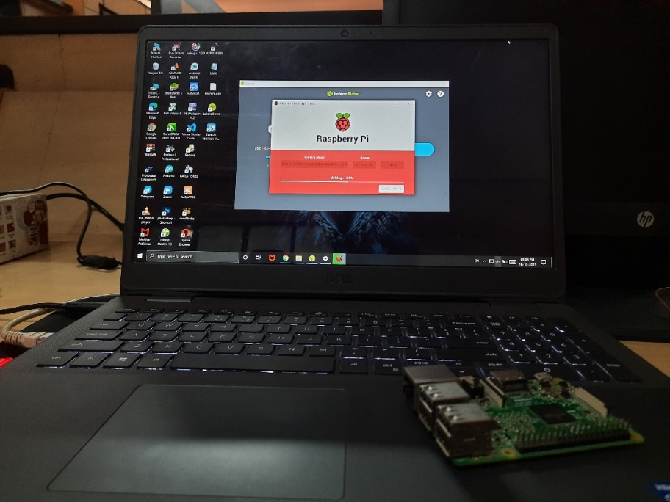
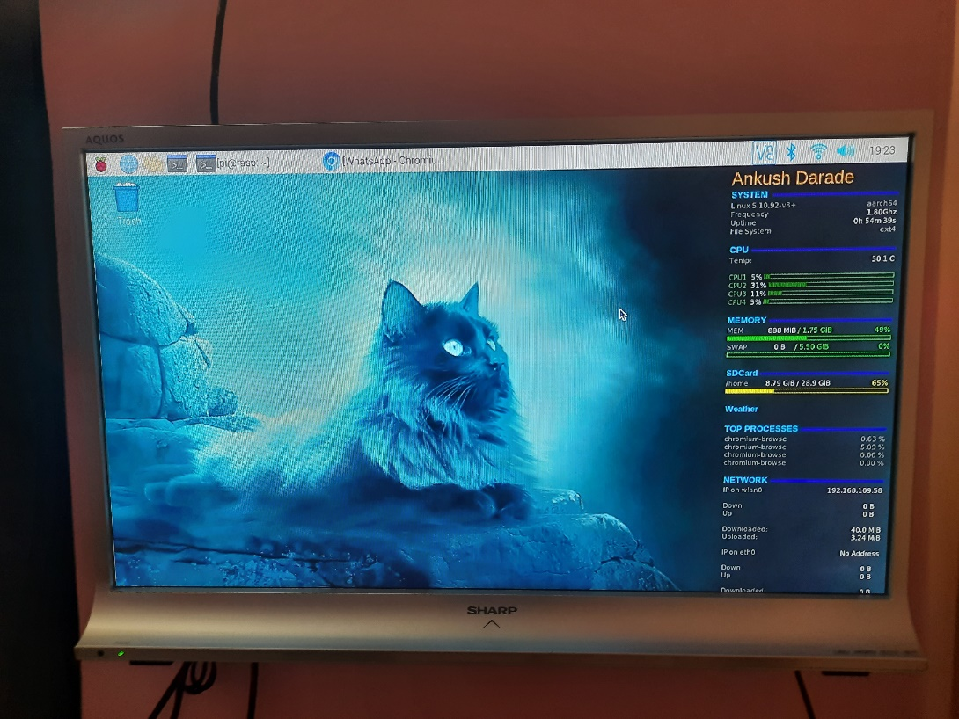
OS Installation and Setup
Installing Raspbian OS
Install Conky and Increase RAM

Slide 23
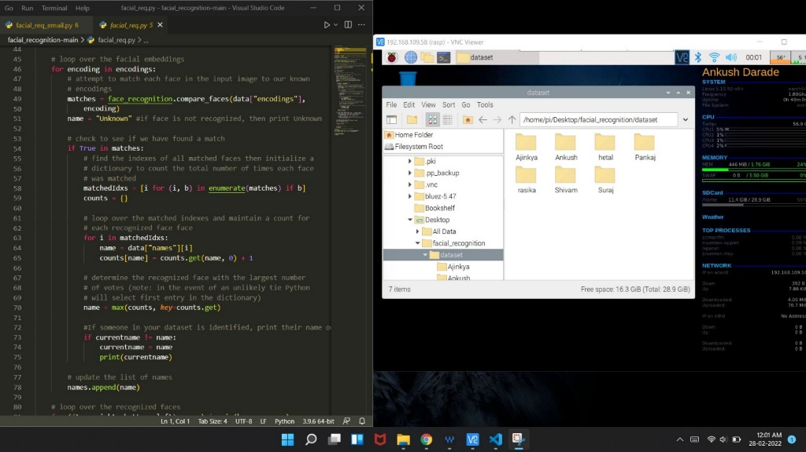
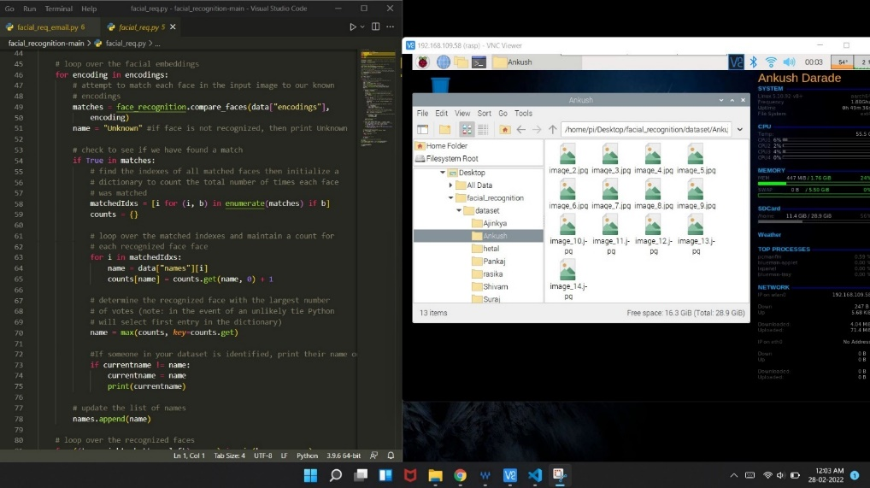
Save Database

Slide 24
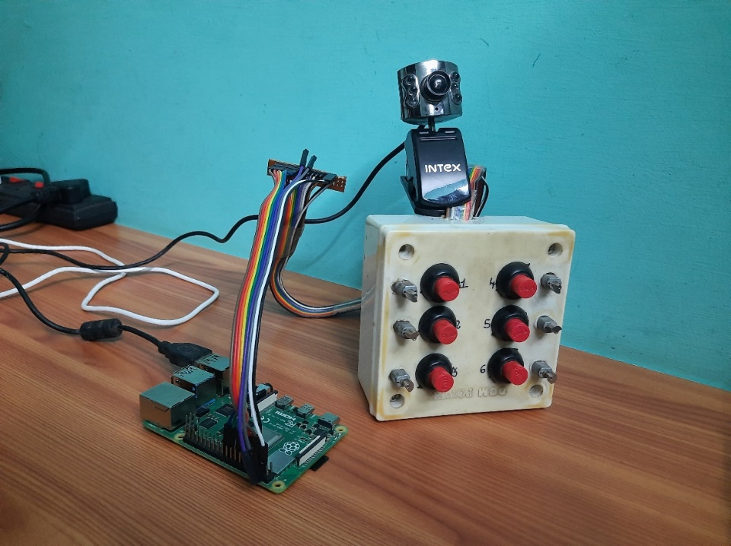
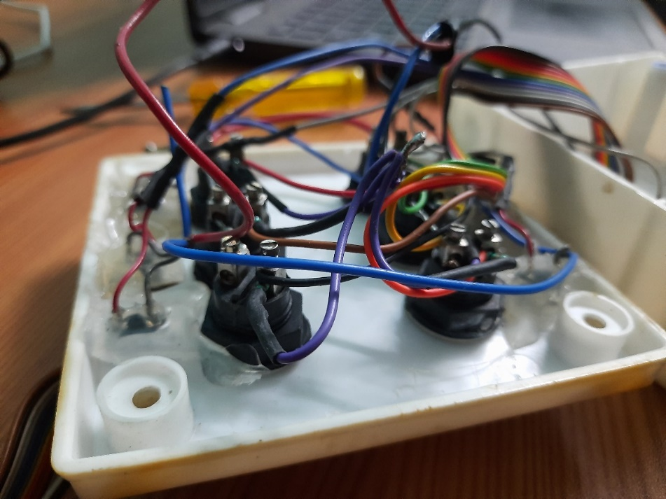
Connection
Hardware Connection

Slide 25

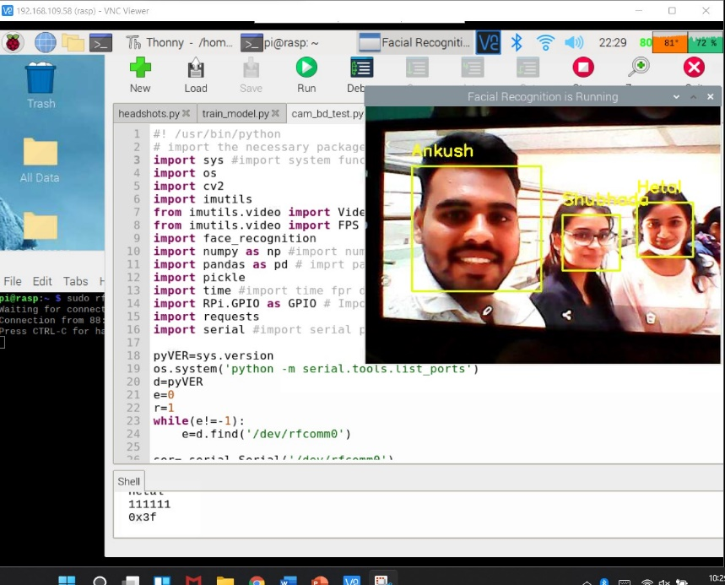
Result : Face Detection
If face Match Found It shows Name and spoken out

Slide 26
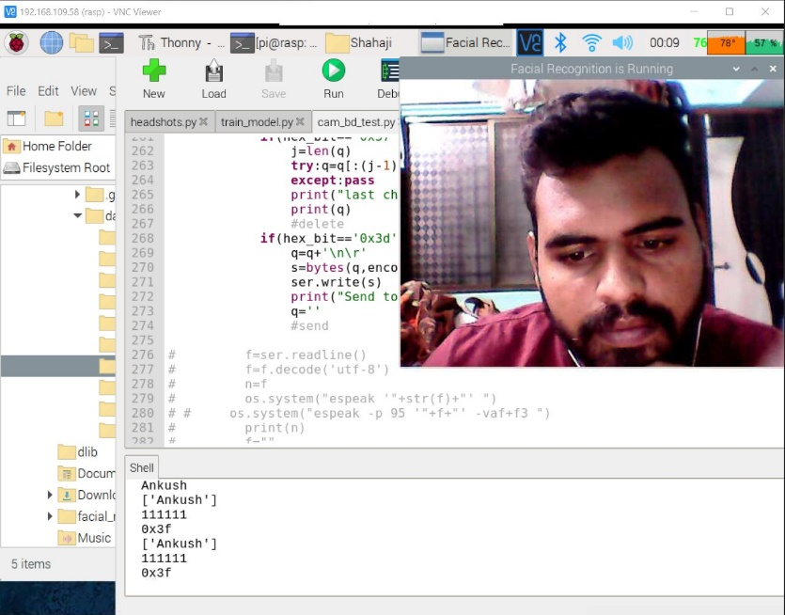
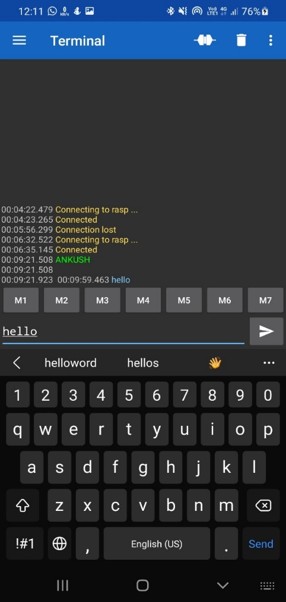
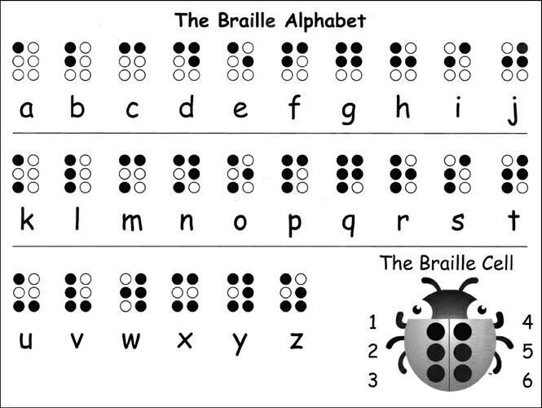
Result: Blind To Deaf Communication
When the blind wants to send Ankush word to the deaf-dumb then user presses the braille board pattern.
Then the code is converted to text using controller.
Then the controller sent the message to the deaf-dump’s mobile device using Bluetooth.
Then Ankush is received and Displayed on the Mobile Device

Slide 27
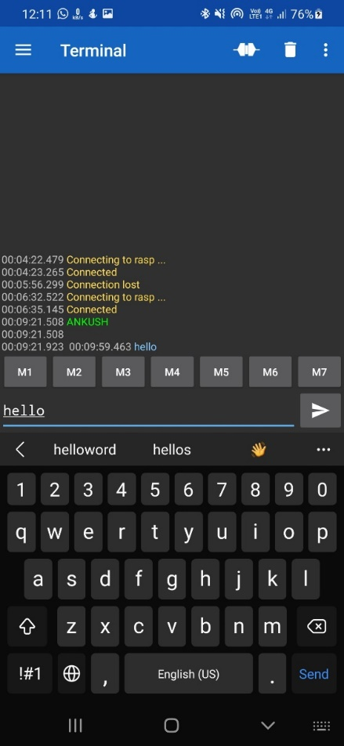
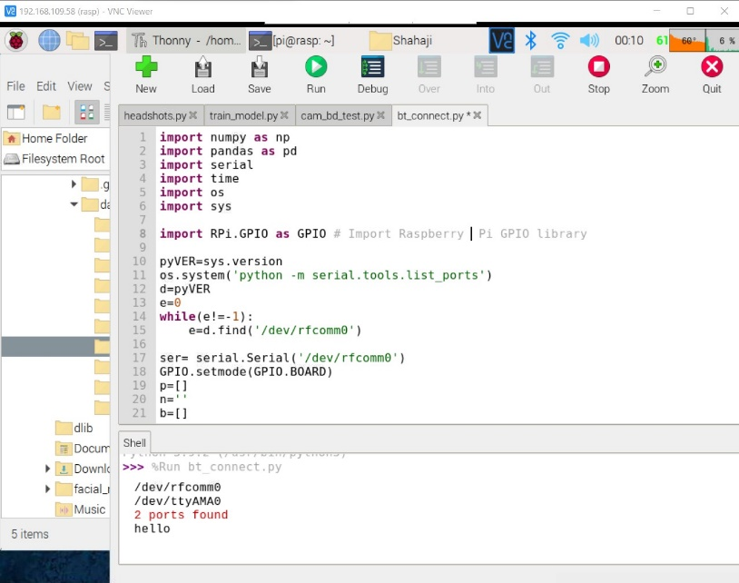
References
When the Deaf-blind wants to send “Hello” text to blind then enters the text on the mobile device.
Then the code is sent to the controller through the Bluetooth
Then the controller receives the message and it convert text to speech
The message sent by the deaf-dump is read by the controller and output is delivered by the speaker.

Slide 28
References
Savindu H.P.,Iroshan K.A.,Panangala C.D., Perera W.L.D.W.P., De Silva A.C. (MIEEE) (2017) Braille Band: Blind support haptic wearable band for communication using braille language https://sci-hub.se/https://ieeexplore.ieee.org/abstract/document/8122806
Hasan U. Zaman, Khalida Sultana Shuravi, Muntasir Kabir Sakib, Mohammad Wasee Sarwar, Department of Electrical and Computer Engineering North South University Dhaka, Bangladesh (2017) A Low-Cost Wireless Braille System Hand Glove for Real Time Communication https://sci-hub.se/https://ieeexplore.ieee.org/document/9068769
Ms. Rashmi R Gundams, Sonail S Handigundms, Sudharani S Biradar, Department of Electronics and Communication Engineering, S D M College Of Engineering And Technology, Dharwad (2019) Computerized Deaf, Dumb And Blind http://www.kscst.iisc.ernet.in/spp/39_series/SPP39S/02_Exhibition_Projects/164_39S_BE_0440.pdf
Riham AL Nazer , Nadeen Shaheen, Palestine Polytechnic University College of Information Technology and Computer Engineering.(2018) Smart Glove for Blind and Deaf Blind People http://scholar.ppu.edu/bitstream/handle/123456789/1317/Smartglove.pdf?sequence=1&isAllowed=y
Dipti Jadhav Dr. Amiya Tripathy Department of Computer Engineering, Don Bosco Institute of Technology Mumbai, India(2018) Gesture Aided Speech for Deaf and Mute https://ieeexplore.ieee.org/document/8529411

Slide 29
References
P.V.N. Reddy Professor, Department of ECE, S V College of Engineering, Tirupati, A.P, India.(2012) Text to Speech Conversion Using Raspberry Pi for Embedded System. http://www.ijirset.com/upload/november/19_2012_ece_1_SET_ISS%201.pdf
World Health Organization https://www.who.int
Raspberry pi 3b+ https://www.raspberrypi.com/products/raspberry-pi-3-model-b-plus/
Raspberry pi https://www.amazon.in/dp/B07BFH96M3/ref=cm_sw_em_r_mt_dp_6AP5MJ4W4R28QFFZS0HG
Sd card https://www.amazon.in/dp/B08GYBBBBH/ref=cm_sw_em_r_mt_dp_NVK509K3ZX4VSR68C4BM
Camera https://www.amazon.in/dp/B08KT89BWX/ref=cm_sw_em_r_mt_dp_5EF0SX3FFSMJSWQ31SBC?_encoding=UTF8&psc=
https://www.pharmabraille.com/pharmaceutical-braille/the-braille-alphabet/
https://www.afb.org/blindness-and-low-vision/braille/what-braille#:~:text=Braille%20is%20a%20system%20of,Braille%20is%20not%20a%20language.
www.google.com
www.raspberry.io

Slide 30

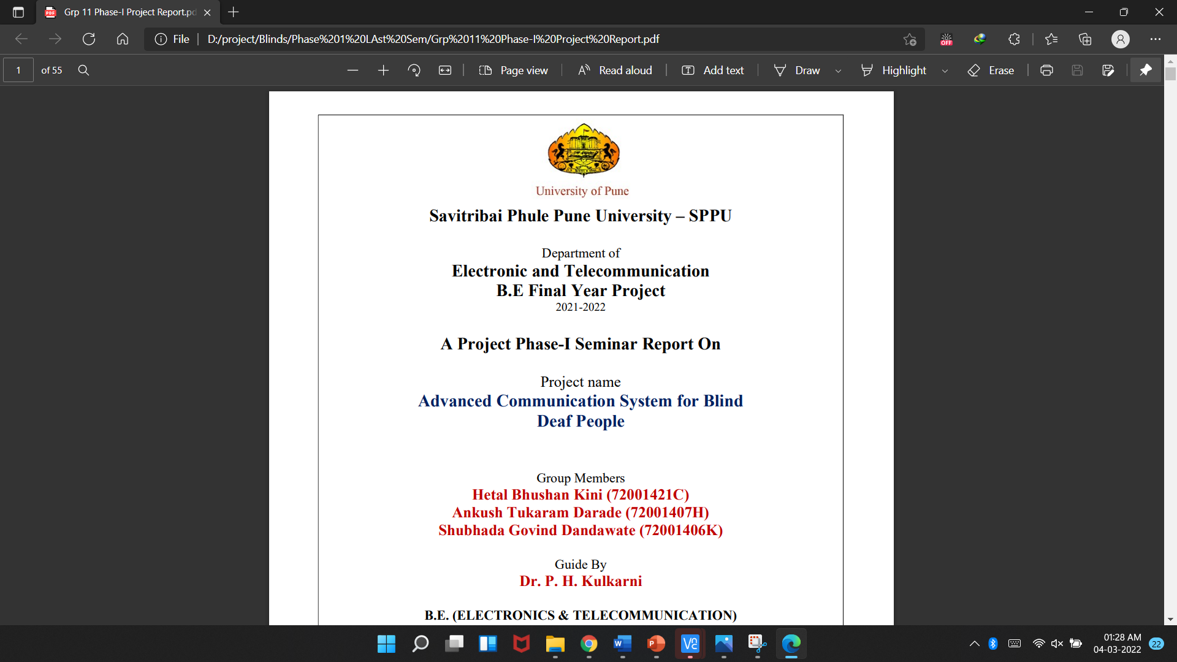
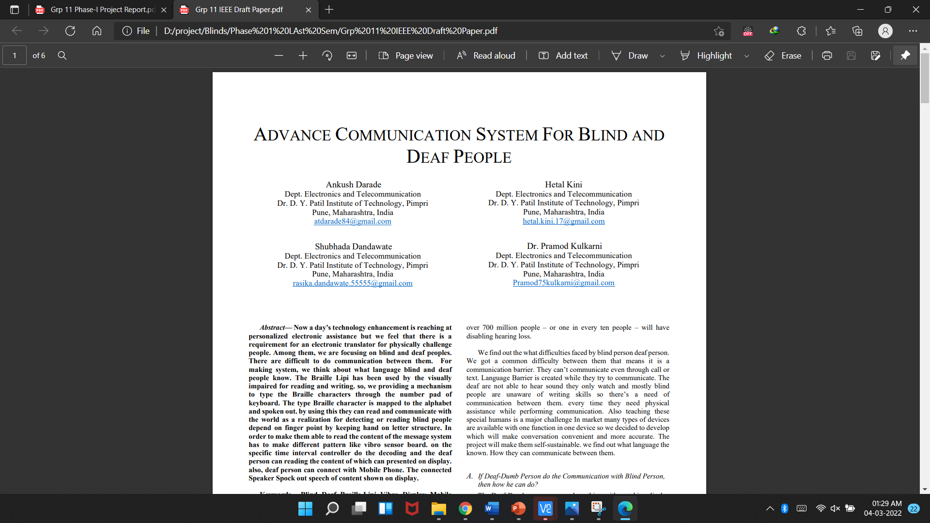
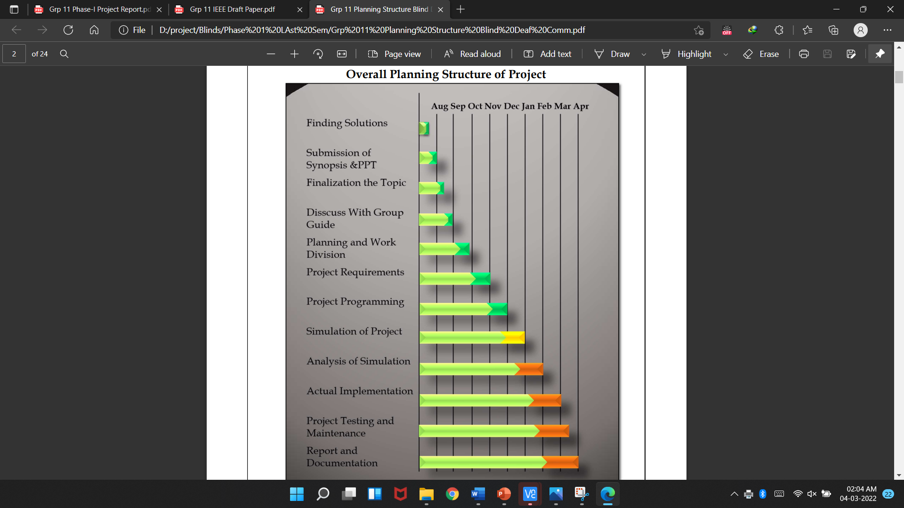
Report And Paper Format Report

Slide 31
Thank you

